Slide 1

Hotel aggregate Analysis report
This analysis consists of how the hotel is rated , and its analysis of hows its rated and sepearted by the visual analyzation tool called power bi.
Using power bi we can analyze the given dataset and we can analyze the top rated hotel basecd of the contnts of the dataset given

Slide 2
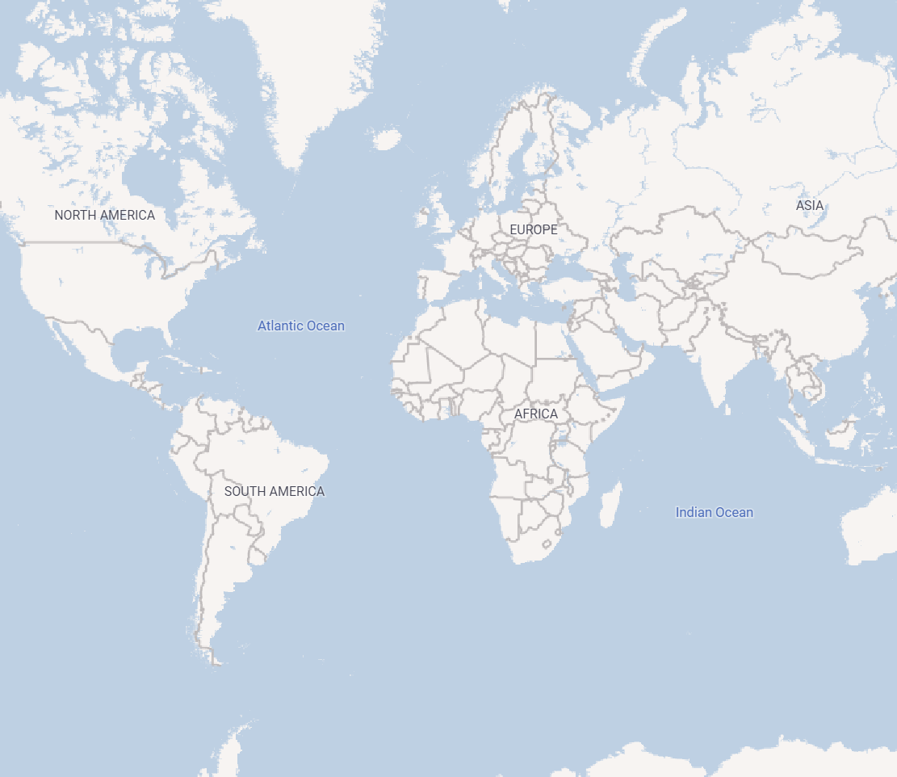
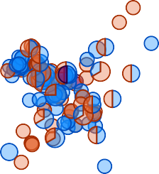
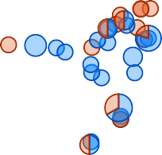

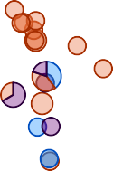
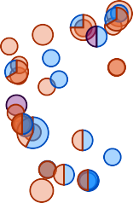


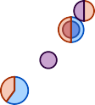
Country  (Blank)  AL  Argentina  Australia  Austria  Bangladesh  Belgium  Brazil
Geographical Insights
room_type Entire home/apt
Hotel room
Private room
Shared room
State   Abbotsford  Aberfeldie  Adelaide  Agnes Water  Aintree  Aireys Inlet  Airport West

Slide 3
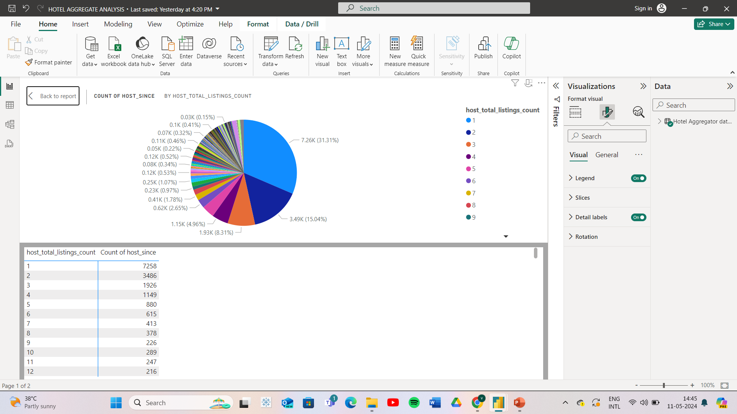

Slide 4
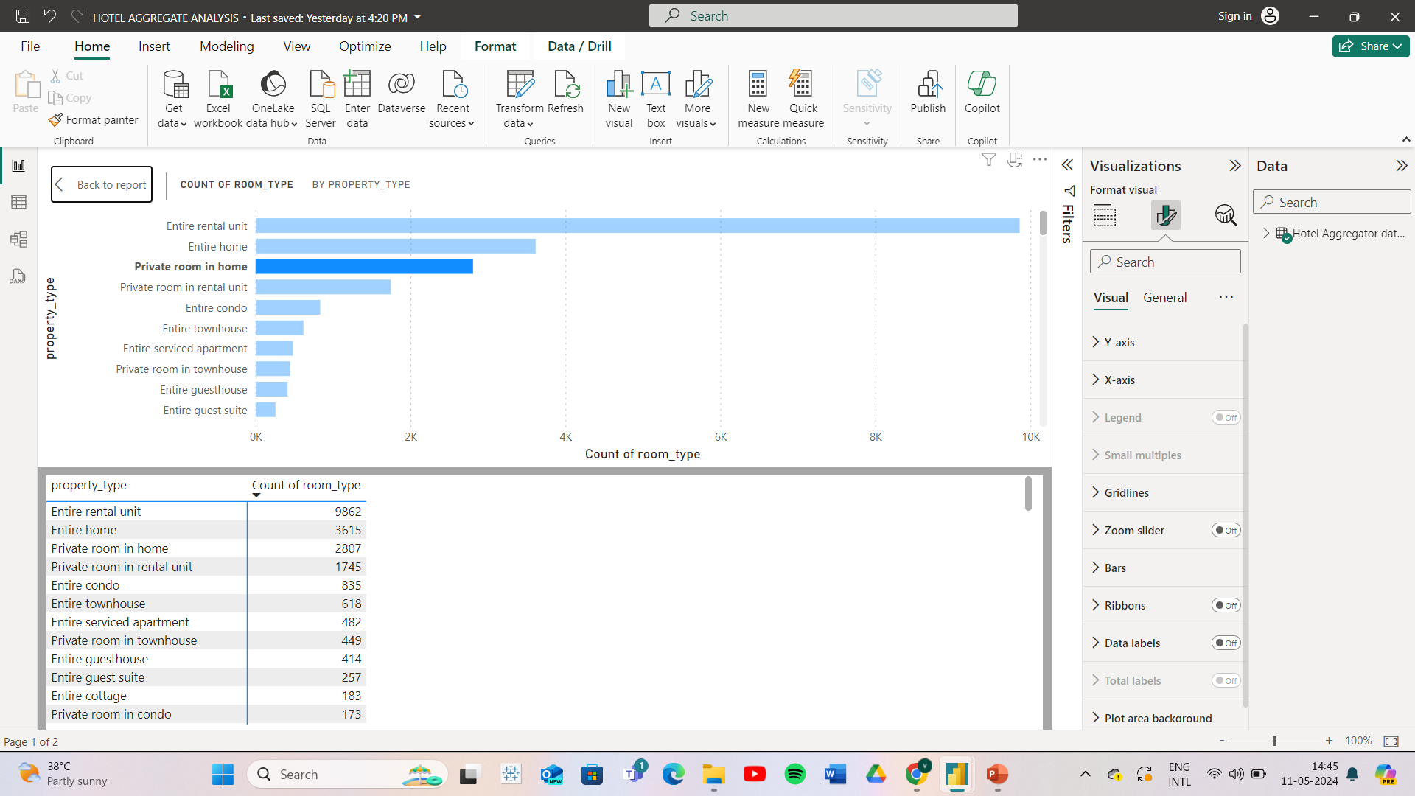

Slide 5
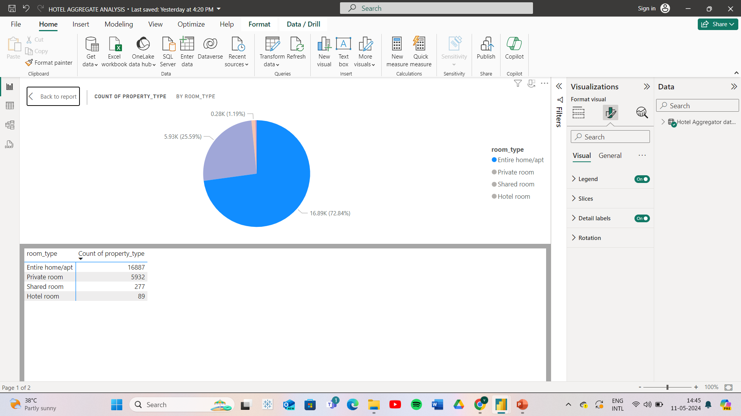

Slide 6
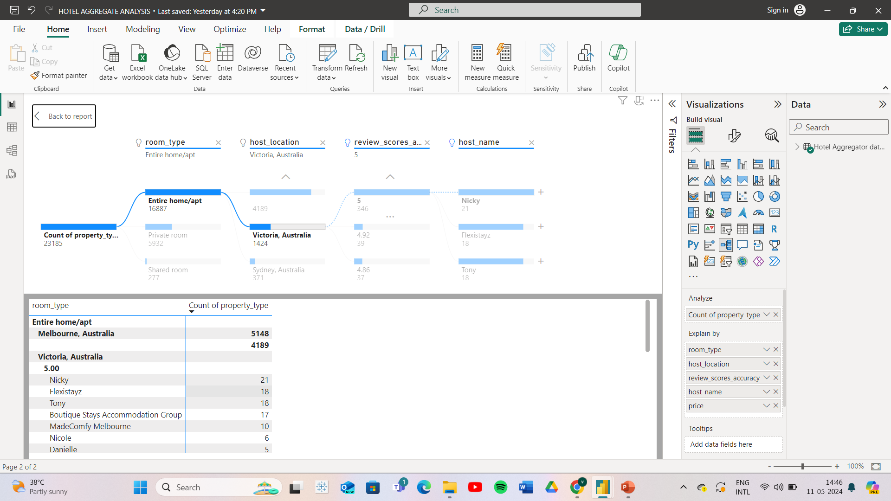

Slide 7
